Slide 1

Team 9: T9-837X Microcontroller

Slide 2
Team 9: T9-837X Microcontroller
Charlie Van Hook
Soud Alkharji
Gidon Gautel
Yoan Zhao

Slide 3


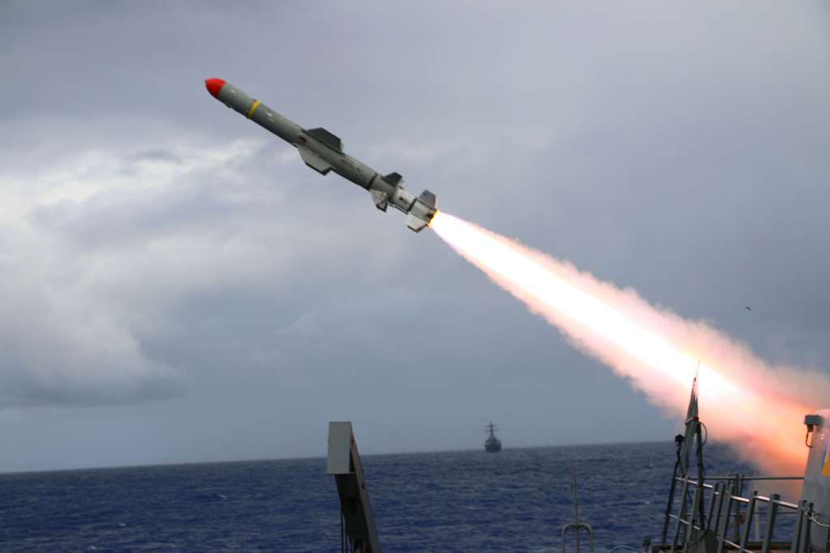
Goal & Motivation
Motivation: Not enough microcontrollers! (and learn system-wide skills)
Goal: Create an easily implementable microcontroller design
Use cases:
Robotics
Wearable Electronics
Control

Slide 4
Functionality: Project Deliverables
Design Phase
Architectural Design
Microprocessor architecture
Datapath components
Control signals and timing constraints
ISA Design
Define supported instructions
Map instructions to micro-operations in the datapath
Component Design
ALU design
Register File design
Control Unit design
Memory Interface design
Clock and Reset Circuit design
Programmer
Program counter
Implementation Phase
Schematic Design
Integration
Timing Analysis
Peripheral Integration
Simulation and Verification
Testbench Development
Write testbenches for modules
Develop system-level testbenches
Functional Simulation
Verify ISA instruction execution
Simulate edge cases and reset functionality
Test UART-based assembly program loading
Performance Verification
Measure CPI and throughput
Validate interrupt handling
FPGA Deployment
Synthesis
Bitstream Generation
Programming
Physical Testing
Test Setup
Test Program Execution
Debugging
Documentation
Technical Documentation
User Guide
Project Report
Presentation and Deliverables
Demonstration
Source Code
Simulation Results
FPGA Configuration Files

Slide 5

Specification: Key Design Choices
Core Functionality/Design Goals
Harvard architecture
SRAM
Instruction set: MIPS
Functionality:
Digital I/O
ADC
Pulse width modulation
32-bit
Supports multiplication and division
No floats
Stretch Goals:
Multi-process functionality
Interrupt timer
Floats
Longs
Notes:
Yoan

Slide 6
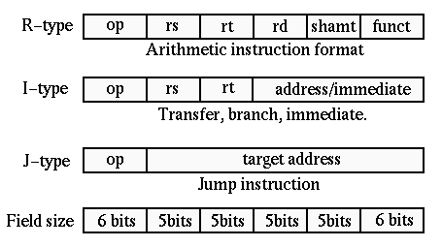
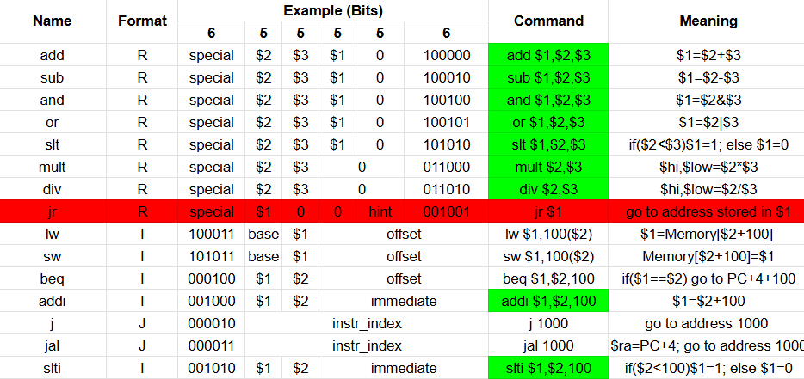
Specification: Supported Assembly Instructions
R-type:
Add
Subtract
And
Or
Multiply
Divide
SLT (Set Less Than)
I-Type:
ADDI (Add Immediate)
SLTI (Set Less Than Immediate)
J-type:
JR (Jump Register)
LW (Load Word)
SW (Save Word)
BEQ (Branch if Equal-to)
BNE (Branch if Not Equal-to)
J (Jump to position)
JAL (Jump and Link)
LHI (Load High)
LLO (Load Low)
Notes:
Soud

Slide 7
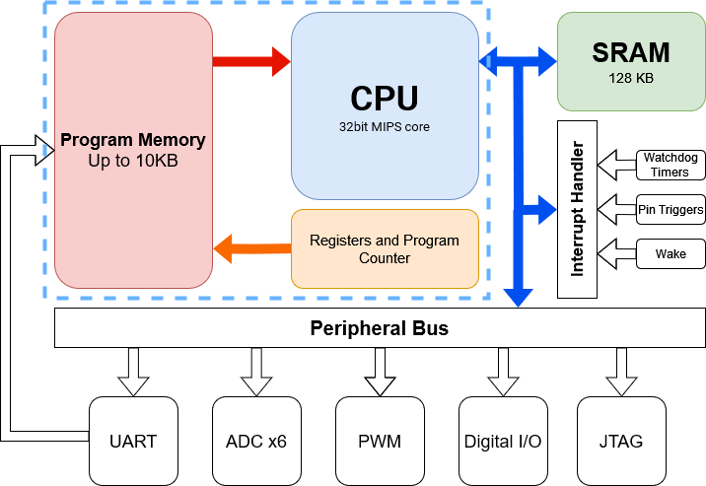
System Block Diagram
Block Diagram Goes Here
Notes:
Charlie

Slide 8
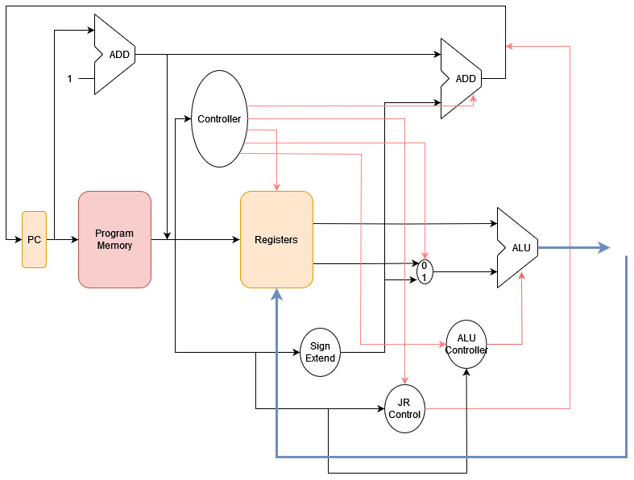
Internal Block Diagram
Memory (SRAM)

Slide 9
Code Snippets
always @(posedge clk or posedge reset) begin
if(reset)
pc_current <= 32'd0;
else
pc_current <= pc_next;
end
assign pc2 = pc_current + 31'd2;
assign im_shift_1 = {imm_ext[30:0],1'b0};
assign no_sign_ext = ~(im_shift_1) + 1'b1;
// PC beq add
assign PC_beq = (im_shift_1[31] == 1'b1) ? (pc2 - no_sign_ext): (pc2 +im_shift_1);
assign beq_control = branch & zero_flag;
assign PC_4beq = (beq_control==1'b1) ? PC_beq : pc2;
assign PC_j = {pc2[31],jump_shift_1};
assign PC_4beqj = (jump == 1'b1) ? PC_j : PC_4beq;
assign PC_jr = reg_read_data_1;
assign pc_next = (JRControl==1'b1) ? PC_jr : PC_4beqj;
How can we implement a Program Counter with jumping, branching, and waiting
Certain operations are atomic (fetching data from registers, and, or, etc) meaning they take 1 cpu cycle
Others take several(memory actions, multiplication, etc)
We need to flag the program whenever the cpu is waiting on a previous step
We also need to allow the processor to skip steps and return back for jumping operations

Slide 10
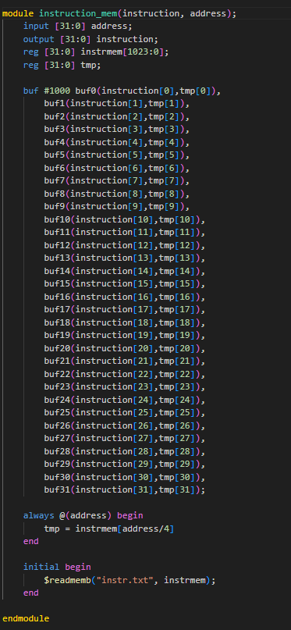


Code Snippets (cont.)
module instruction_mem(instruction, address);
input [31:0] address;
output [31:0] instruction;
reg [31:0] instrmem[1023:0];
reg [31:0] tmp;
buf #1000 buf0(instruction[0],tmp[0]),
buf1(instruction[1],tmp[1]),
. . .
buf31(instruction[31],tmp[31]);
always @(address) begin
tmp = instrmem[address/4]
end
initial begin
$readmemb("instr.txt", instrmem);
end
endmodule
How can we use testing methodologies for a complex system in Verilog?
I dunno but I wrote some code to help
00111000000100000000000000000011
00111000000100010000000000000100
00001000000000000000000000000101
00111000000100000000000000000001
00111000000100010000000000000001
00000010001100001001000000100010
00010110000100011111111111111100
00000010000100011001100000100000
10101110010100110000000000010000
10001110010101000000000000010000
00000010000101001010100000101010
10001110010100110000000000010000
00111010010100110000000000000001
00111010101101010000000000000001
00000010101000000000000000001000
Instr.txt, output.txt
BASH

Slide 11
Project Successes, Improvements
Successes:
Working Processor!
Working ALU
ALU controller
Jump controller
Program counter
Register file
Instruction memory
Data memory
UART programmer
Interrupt handler
Novel testing methods
Assembly literacy achieved
Still working on:
Peripheral bus
Testing campaign (particularly system-level & hardware testing)
Lessons learned:
Module-level testbenches do not scale well
Utilize Vivado pre-build tools to avoid unnecessary wasted time
Use Python to simplify ISA encoding
Notes:
Successes: Soud, To improve on: Yoan

Slide 12
Thank you for listening!

